Slide 1
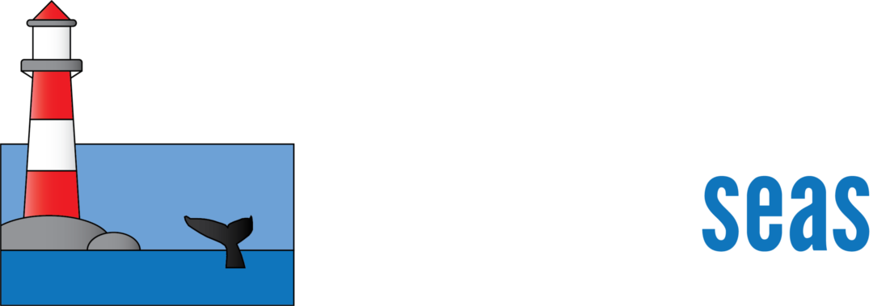
Marine Managed Area Mapping
Experiments in Depiction
Virgil Zetterlind
virgil@anthinst.org
Notes:
We are the Anthropocene Inst a privately funded conservation foundation. Part of our mission is to promote and enhance ocean conservation, and is accomplished by the Protected Seas. Protected Seas focuses on ocean conservation, specifically marine managed area mapping. Here we are creating a comprehensive database of marine managed areas location and rules and regulations.

Slide 2
Depicting Marine Managed Areas
Leveraged Anthropocene Institute’s Marine Managed Area Mapping project and online visualization
https://mpa.protectedseas.net
~3500 US protected or otherwise conservation managed areas in coastal waters
Focused on Hawaii region for experiments
Large scale variation in surface area of zones
Large variation on zone restrictions at different scales
Built using Leaflet / PostGIS / Mapbox for quick prototyping
NOAA RNC tile service used as background layer
Notes:
Our goal to to make this information available to as many users as possible
Stay up-to-date through legal alerts, listserves, and contacts with agencies

Slide 3
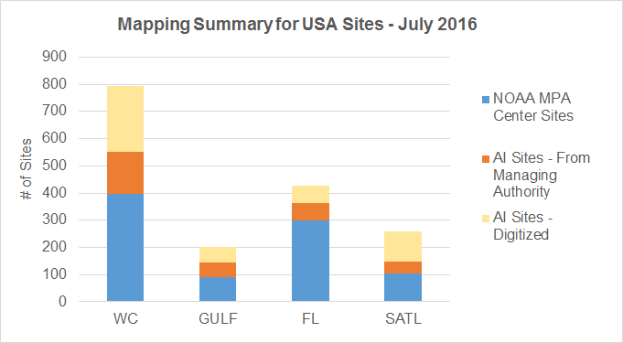
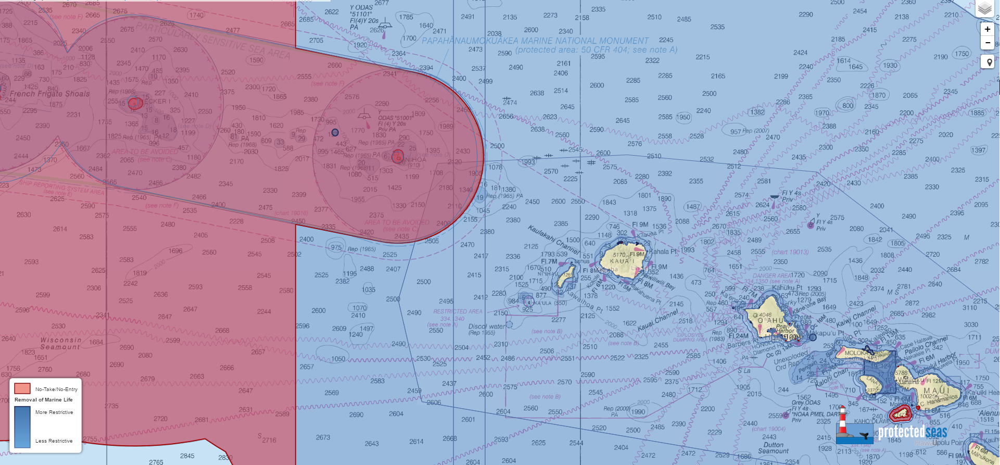
Original Map - Focused on Highlighting Extraction Restrictions in Web Format
Notes:
Collated + Created maps (Make the transition here, really walk through what the graph is and don’t assume indiv. Will know what were talking about) about half of our site we got from noaa, a quarter we got from the managing auth. And a quarter we digitized. And then that is a good transition point.

Slide 4
NIPWG Prototype - Focus on Depicting MPAs in Navigation
Removed fill colors to reduce clutter over charts
Used a red hatching pattern for no-take areas -- these are the most restrictive short of entry restrictions
Changed all but no-take areas to green outlines
Use of ‘T’ lines for boundaries at small map scales
Interactive Demo at: https://mpa.protectedseas.net/north-america/iho
Notes:
Our goal to to make this information available to as many users as possible
Stay up-to-date through legal alerts, listserves, and contacts with agencies

Slide 5
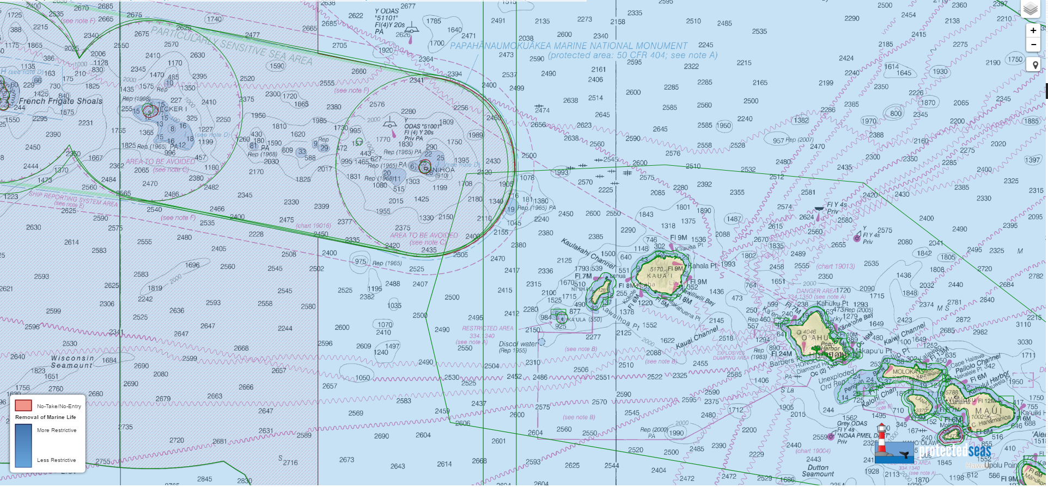
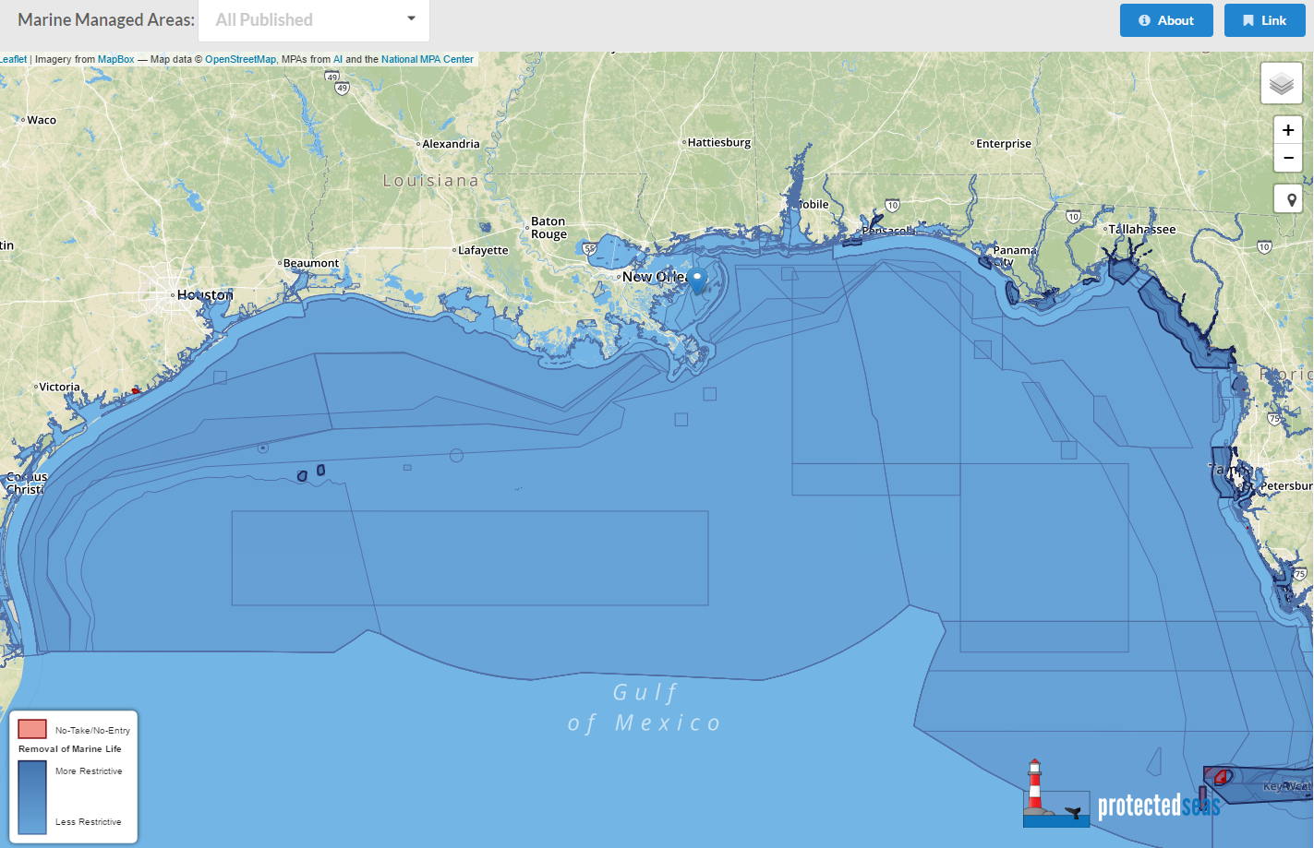
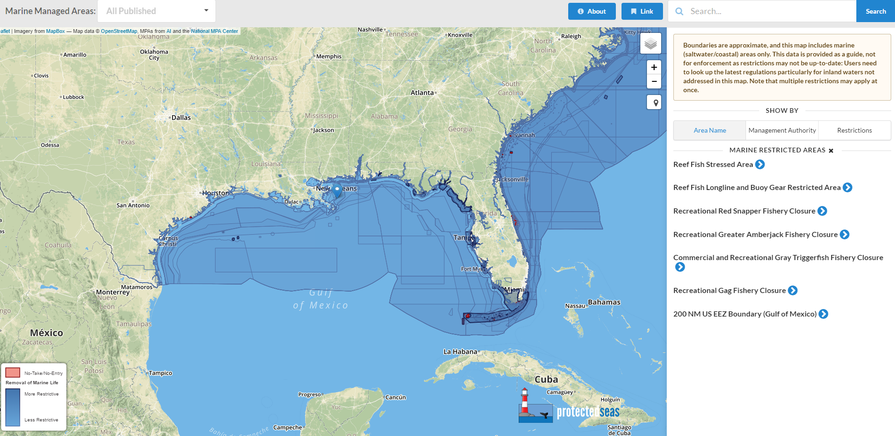
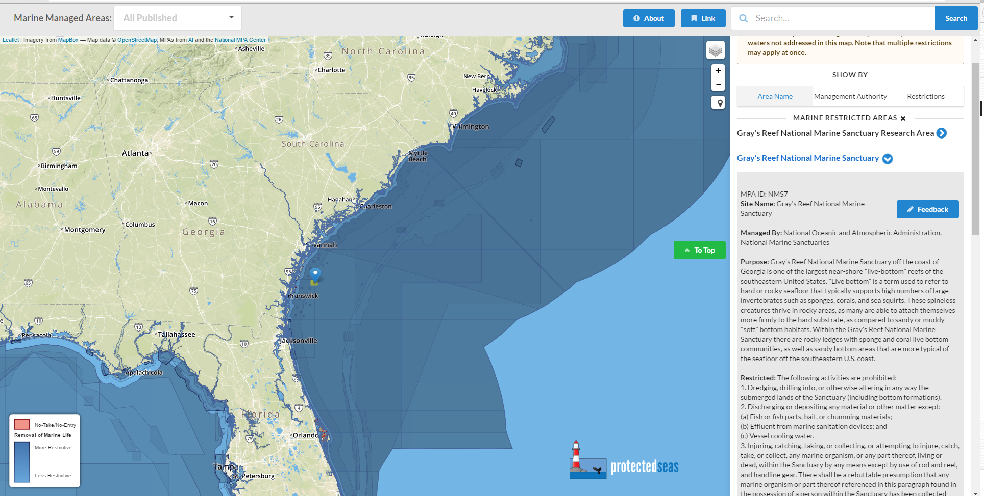
New Map - Large Scale
Notes:
Offer details on site purpose, restricted and allowed activities, where to report violators
Provide links to statutes and codes and other supporting documentation

Slide 6
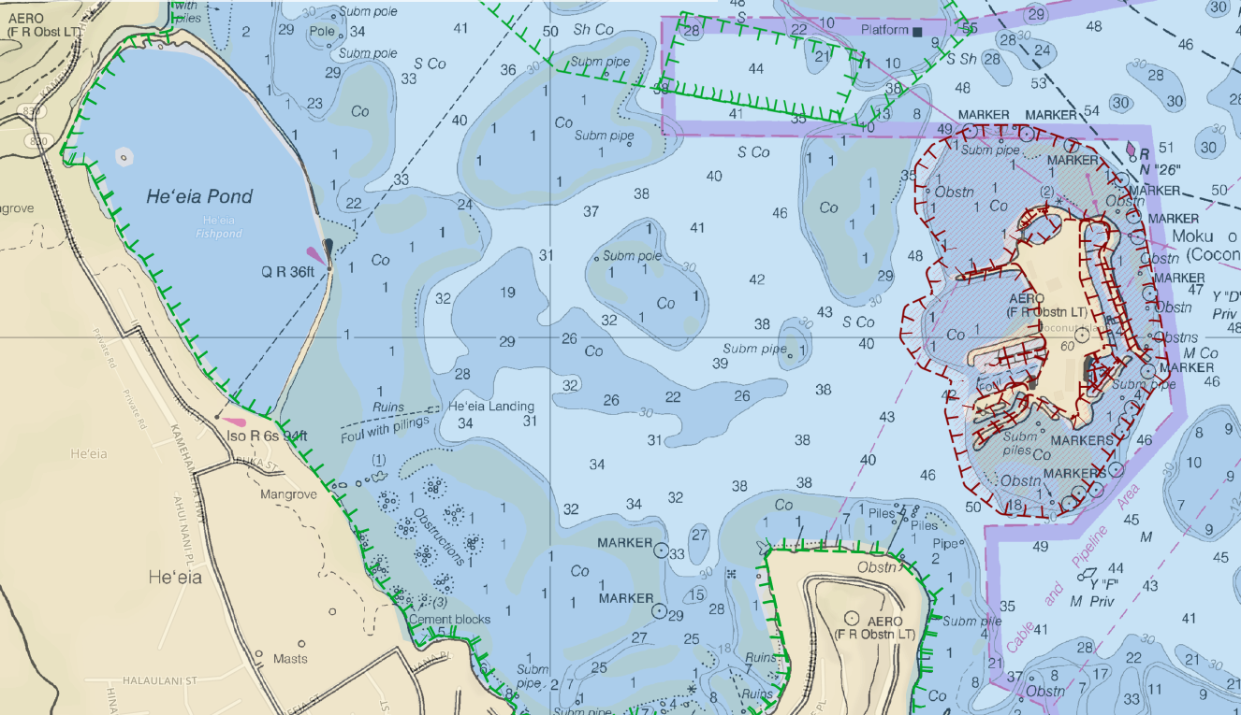
New Map - Small Scale
Notes:
Offer details on site purpose, restricted and allowed activities, where to report violators
Provide links to statutes and codes and other supporting documentation

Slide 7
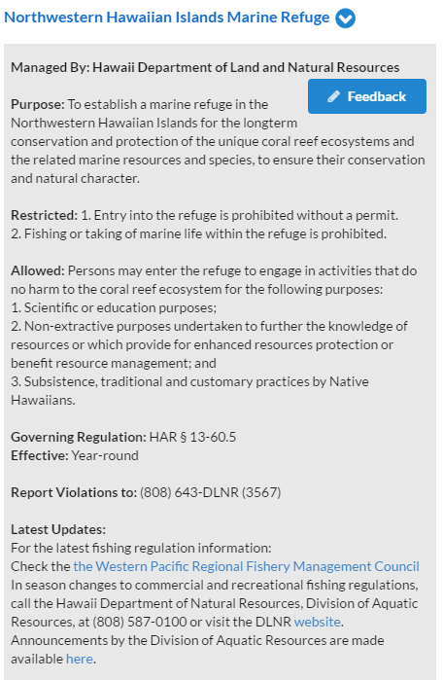
MPA Attributes
Site name
Managing authority
Purpose
Restrictions summary
Exceptions summary
Governing regulation citation (s)
Seasonality (if any)
Violations reporting
Sources for news & updates (phone, web, email, …)
URL links to official ‘homepages’, regulation full text, ...
Notes:
Sites to show:

Slide 8
NIPWG Prototype - Discussion
Depiction:
Should no-take areas receive extra ‘call-out’ vs less restrictive areas?
To what extent should the boundary / fill convey the level of restrictions?
Should boundary / fill attempt to encode specific restrictions, if so, which ones?
No diving
No anchoring
…
Notes:
Our goal to to make this information available to as many users as possible
Stay up-to-date through legal alerts, listserves, and contacts with agencies

Slide 9
NIPWG Prototype - Discussion
Filtering:
Would it be helpful if each MPA’s restrictions were known to apply to
Extraction activities only (fishing, harvesting, mining, …)
Navigation activities only (diving, anchoring, passage)
Both Extraction and Navigation
Commerical vs Recreational only
What are other ways mariners might what to filter for applicability?
Does our S-122 attribute set provide a proper way to define and test these?
Note we have found very few areas in 3500+ US areas that condition applicability or restrictions on vessel size or type
Notes:
Our goal to to make this information available to as many users as possible
Stay up-to-date through legal alerts, listserves, and contacts with agencies

Slide 10
NIPWG Prototype - Discussion
Attributes:
Are new attributes needed for filtering?
Should NIPWG recommend a minimum set of attributes / features to define an MPA?
Should NIPWG recommend a minimum set of attributes to display to a mariner for any MPA?
Notes:
Our goal to to make this information available to as many users as possible
Stay up-to-date through legal alerts, listserves, and contacts with agencies

Slide 11
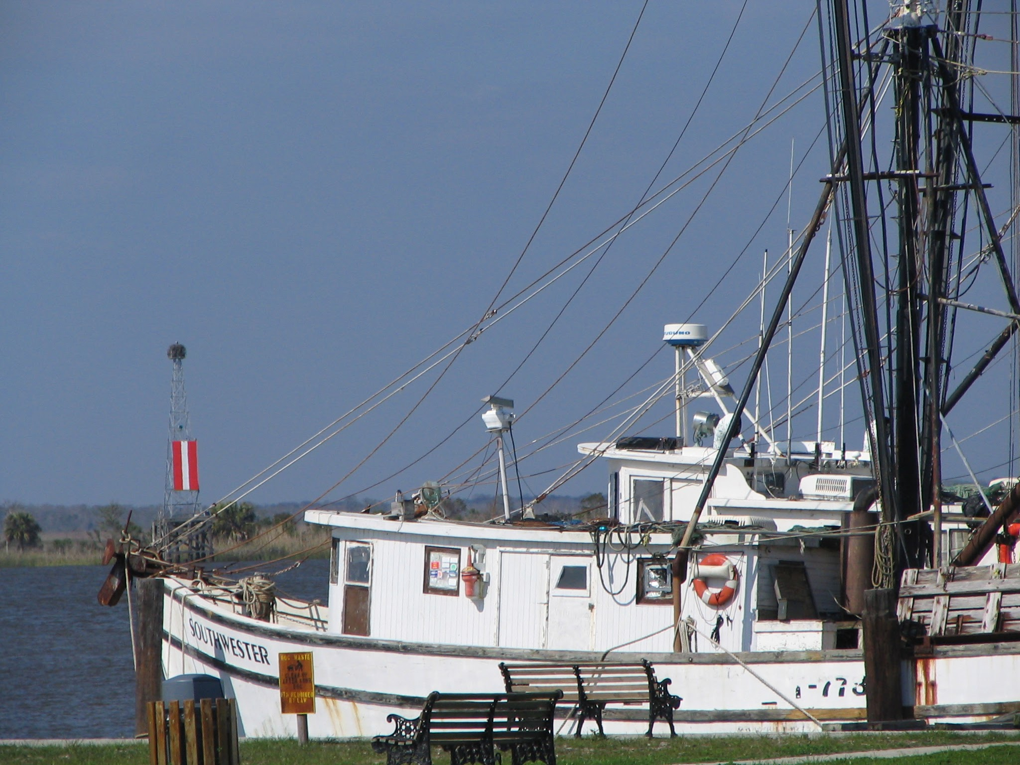
Thank you!
Notes:
See if M2 is applicable, try to integrate maybe?

